Slide 1

Hybrid AI-Powered Adaptive Quiz System
Presented to : DR. Mohammad Aoude
Team :
Rokaya Al Harakeh 6441
Jana Jouni 6348

Slide 2
Problem Statement
Static quizzes fail to address individual differences
Advanced students get bored; beginners get frustrated
Instructors can't personalize quizzes manually at scale

Slide 3
Technical Stack
Frontend | Streamlit
Backend Logic | python
DataBases | SQLite + CSV
NLP/Embeddings | Sentence Transformers
Clustering | Scikit-learn(Kmeans)
Deployment | Docker

Slide 4
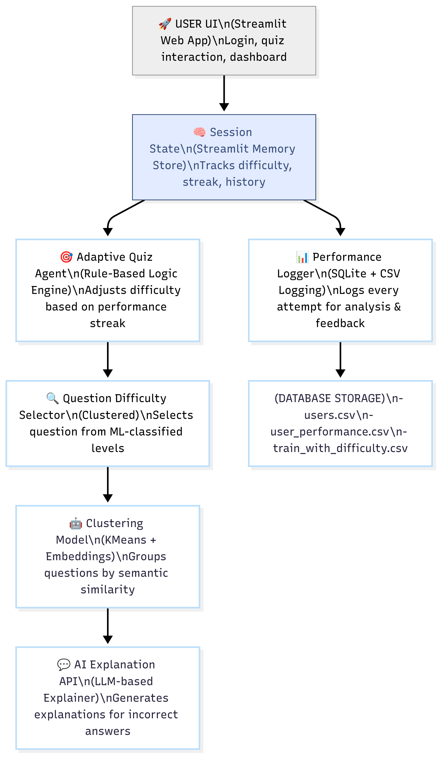
System Overview
Personalized Learning using Rule-Based Logic and Machine Learning

Slide 5
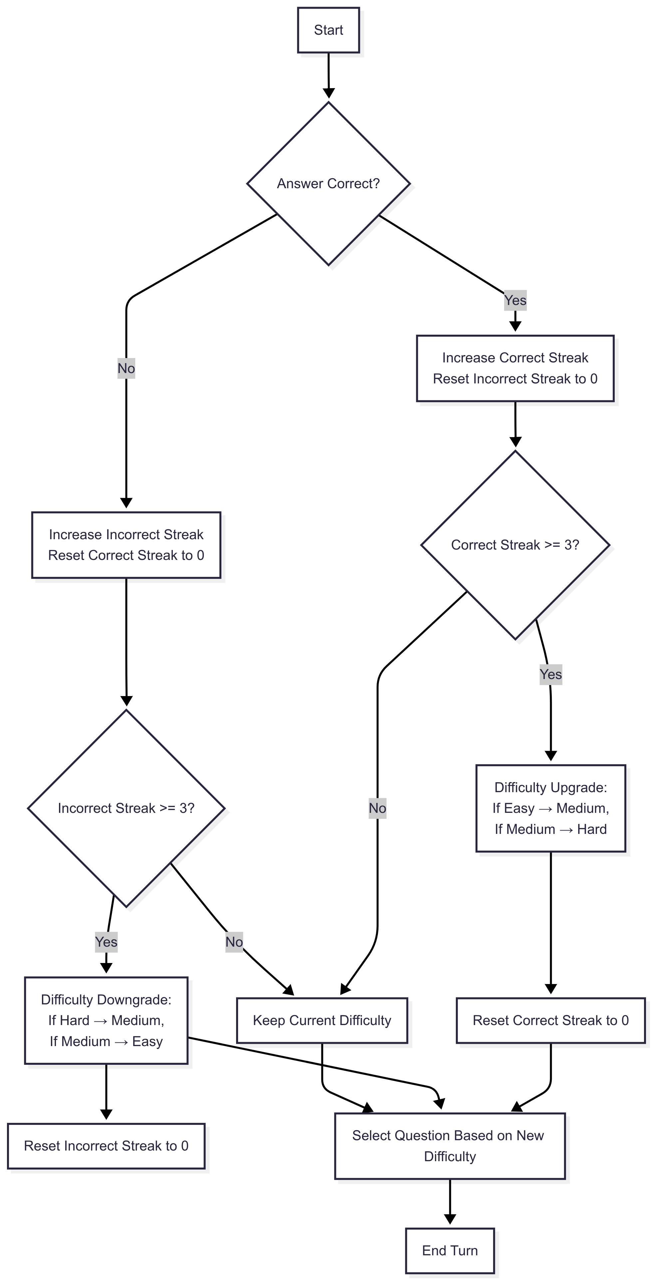
Rule-Based Adaptive Agent (Symbolic AI)

Slide 6
Machine Learning – Question Difficulty Clustering
🧠 Use SentenceTransformer to embed questions (NLP)
🌀 Use KMeans to cluster them into Easy / Medium / Hard
📉 Distance from centroid = complexity
🎯 Reduces manual labeling and bias

Slide 7
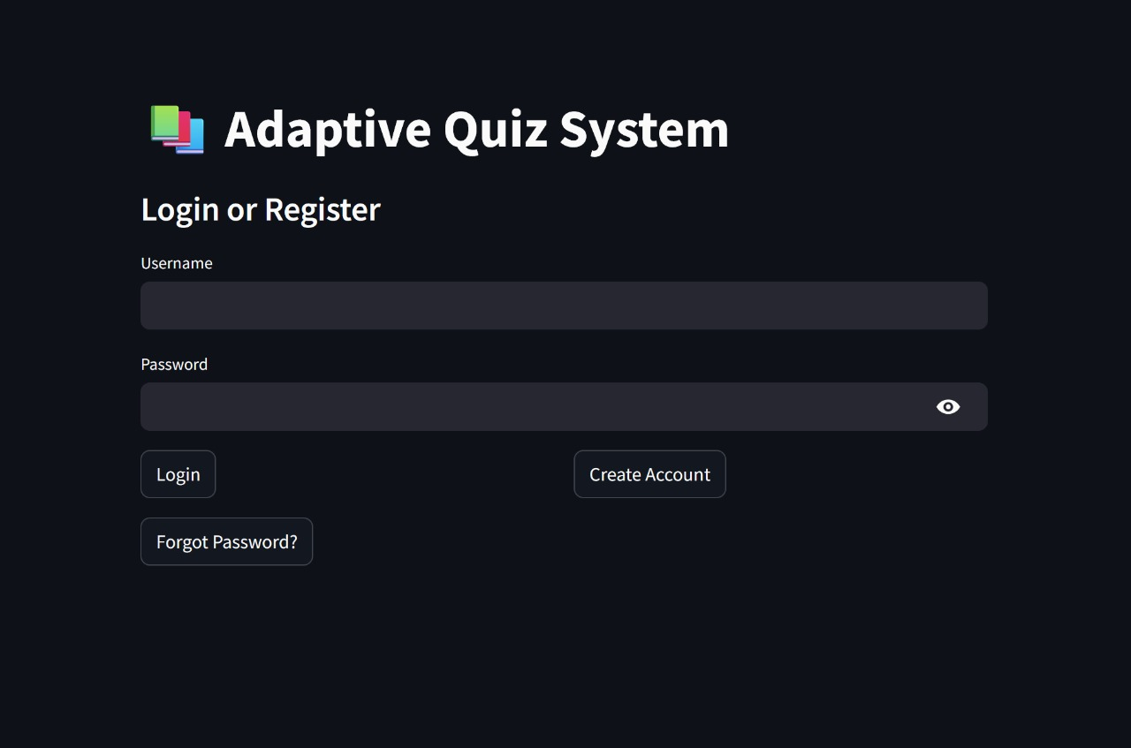
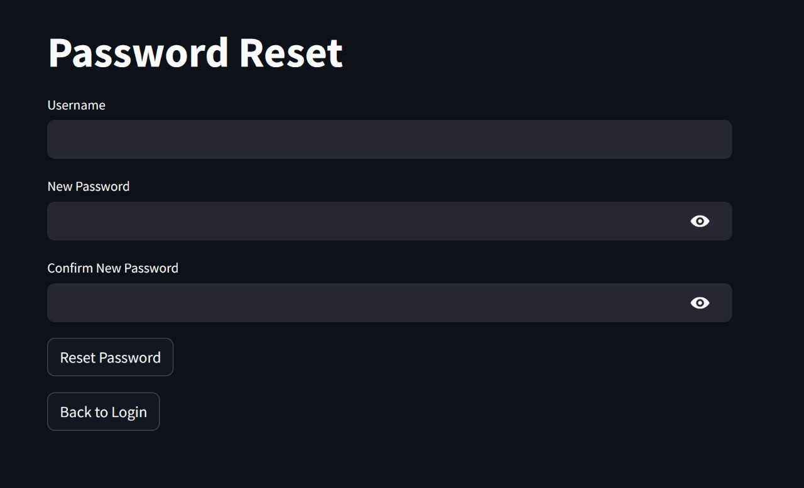
DEMO WALKTHROUGH
01
Login/Register

Slide 8
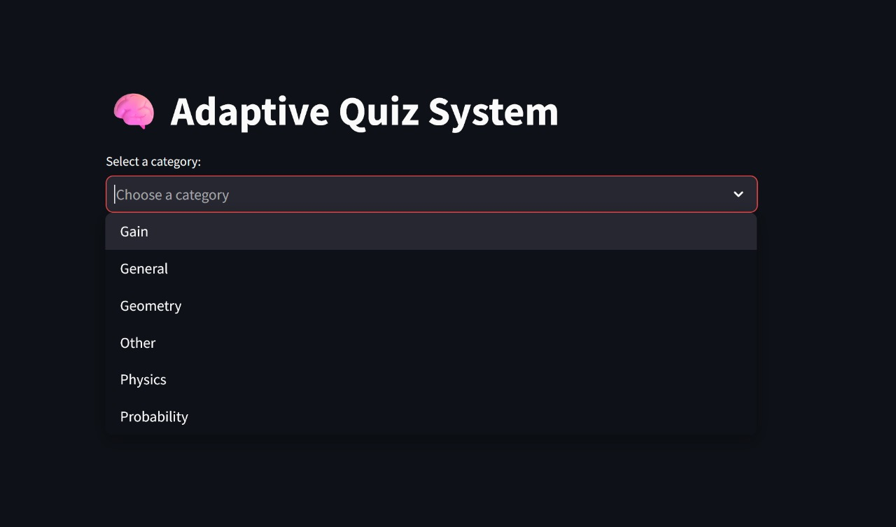
DEMO WALKTHROUGH
02
CATEGORY SELECTION

Slide 9
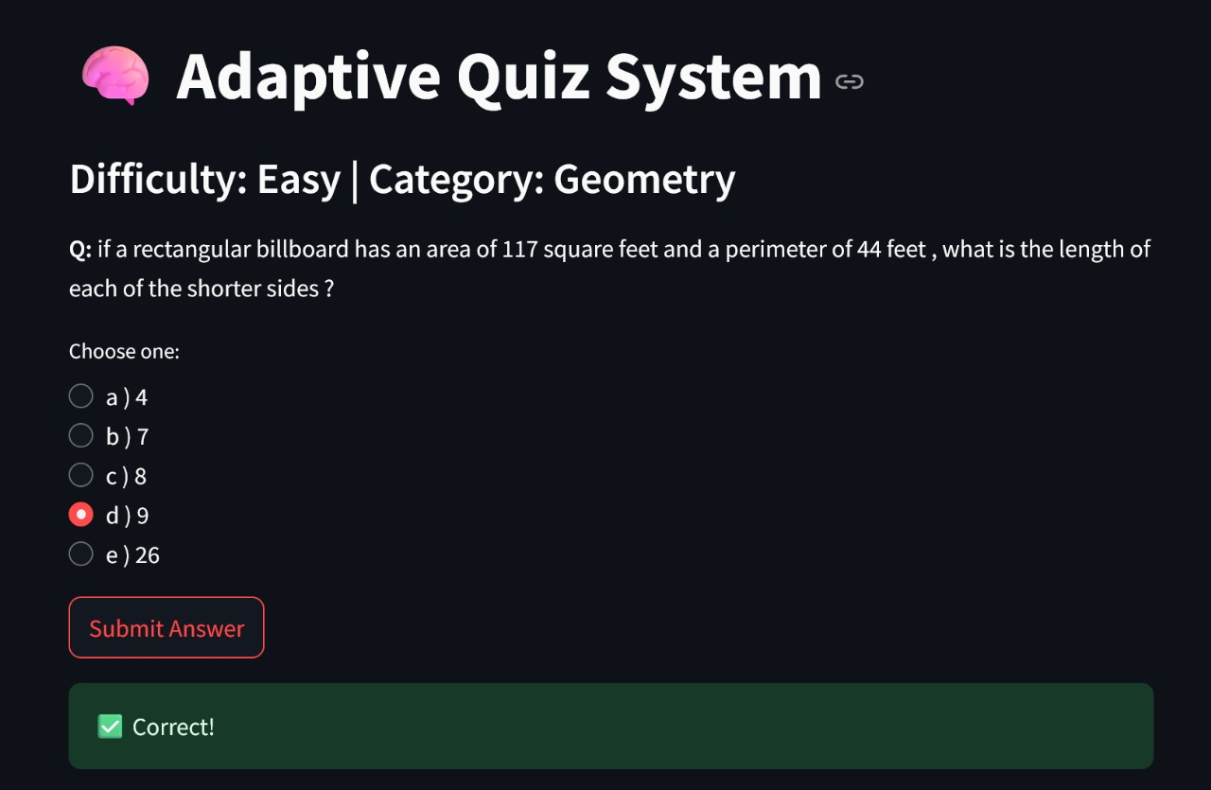
DEMO WALKTHROUGH
03
Adaptive quiz experience

Slide 10
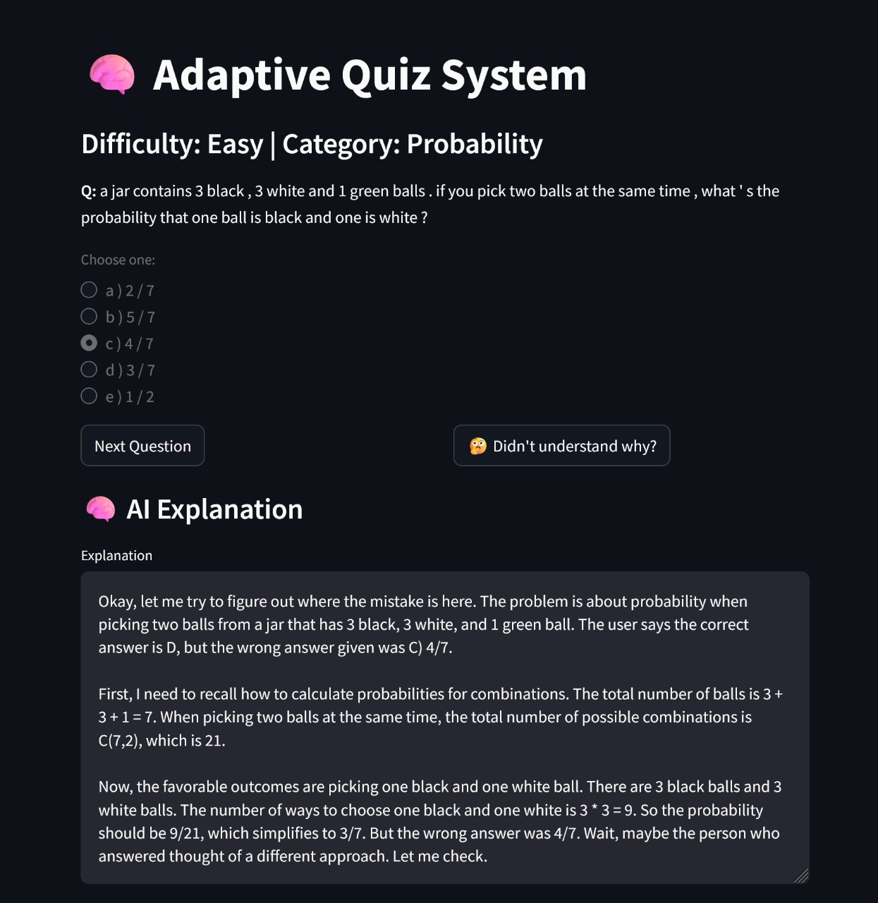
DEMO WALKTHROUGH
04
Explanation request

Slide 11
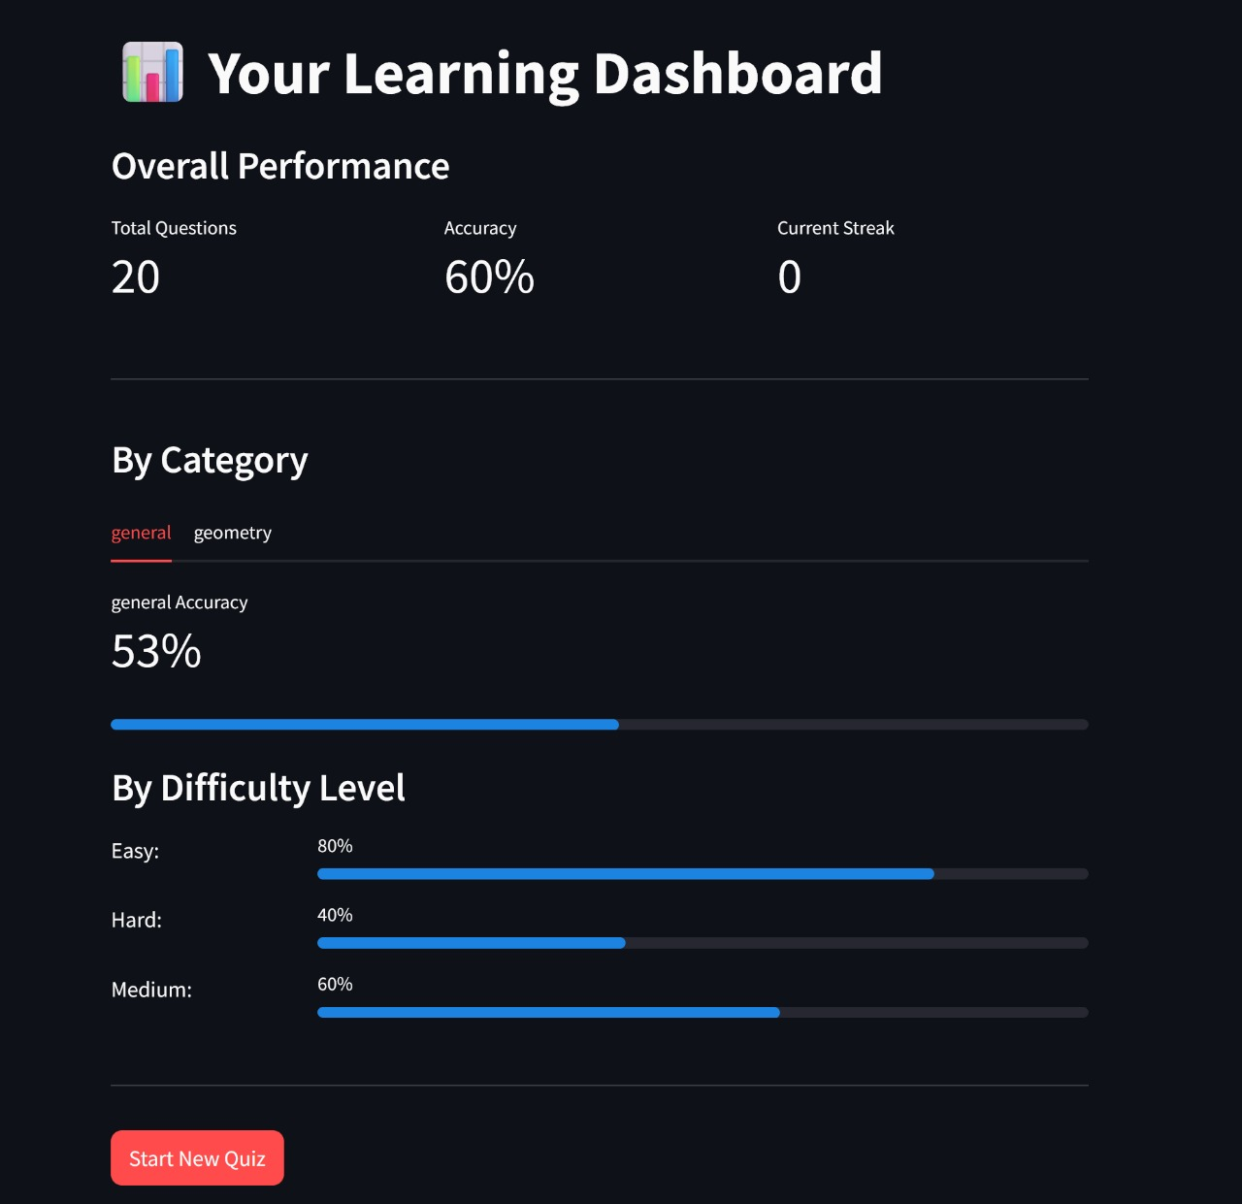
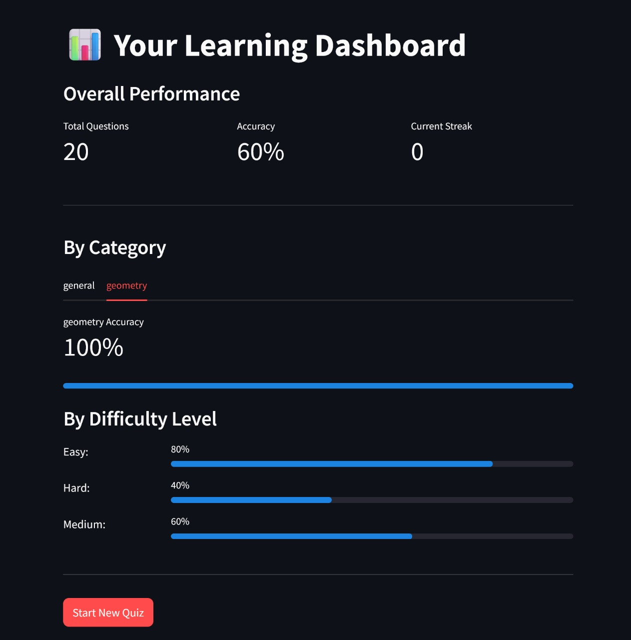
DEMO WALKTHROUGH
05
Performance dashboard

Slide 12
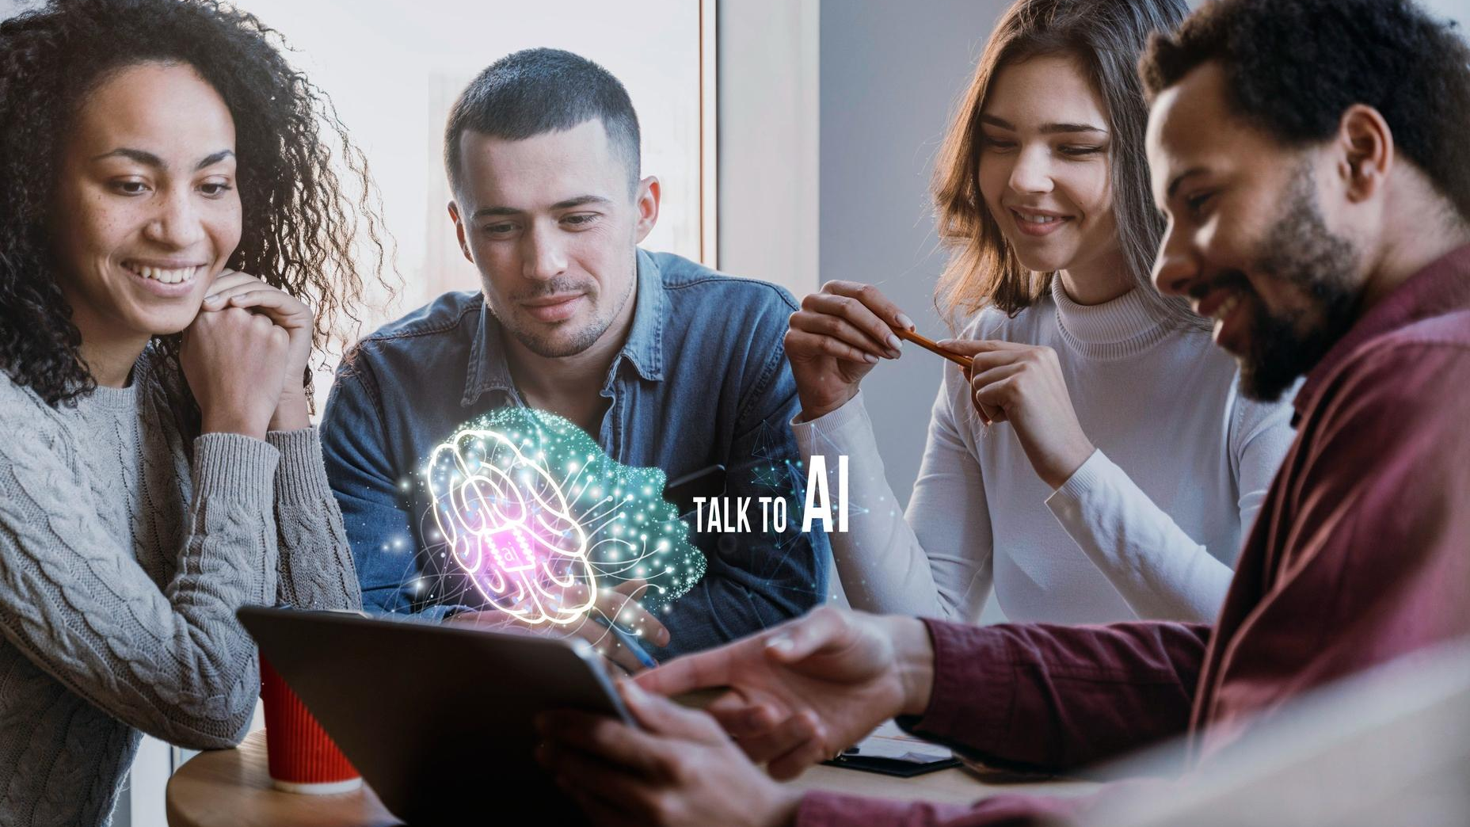
CONCLUSION
This project demonstrates how hybrid AI can enhance education by making learning tools more intelligent, responsive, and accessible.

Slide 13
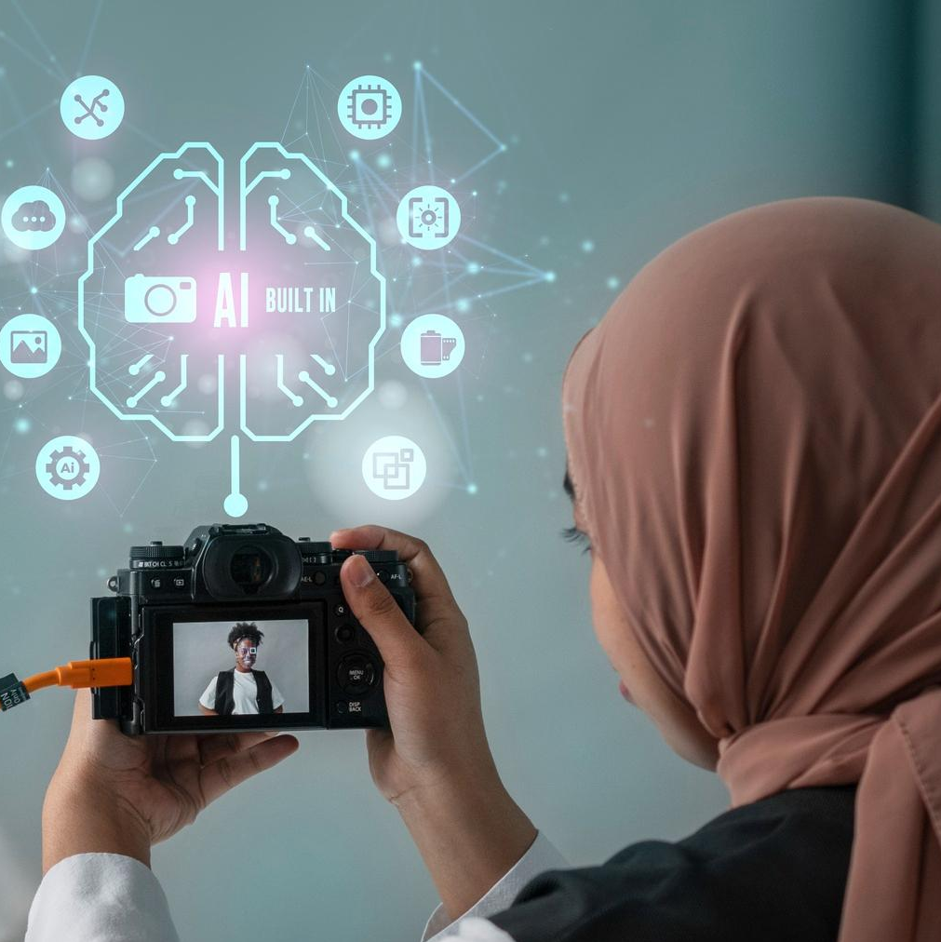
FUTURE IMPROVEMENTS
📊 Personalized learning paths
🧠 Reinforcement learning agent
☁️ Cloud deployment (PostgreSQL + serverless)
📱 Mobile version

